Slide 1
800-241-4949
www.dwihn.org

Slide 2
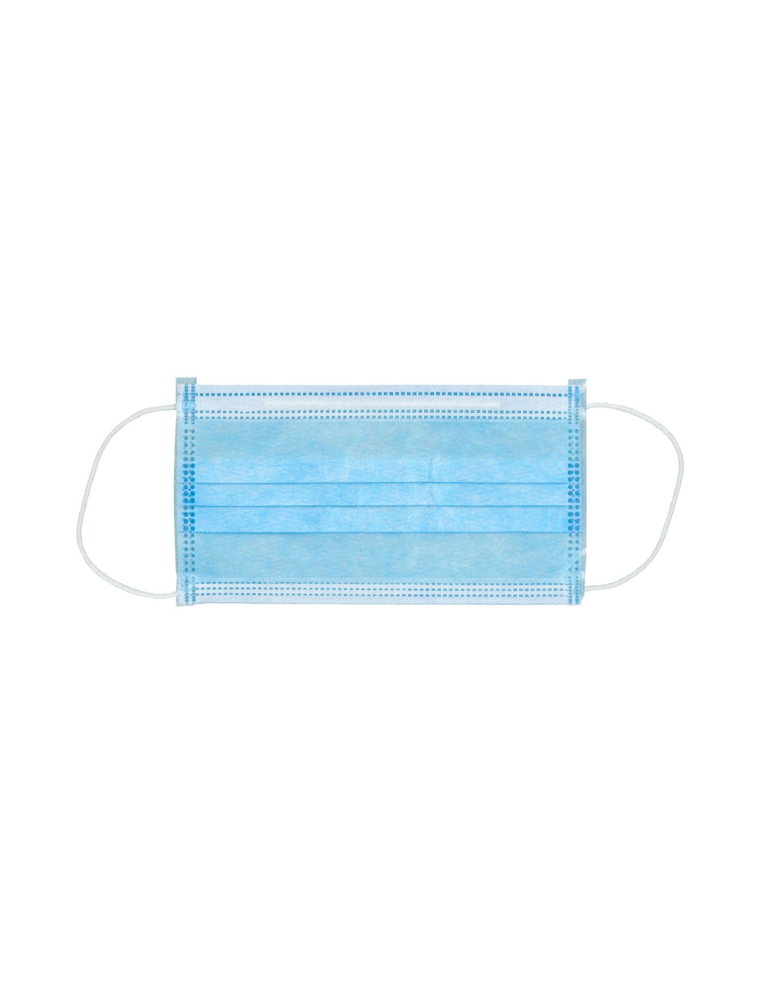
Know About COVID-19 • Coronavirus (COVID-19) is an illness caused by a virus that can spread from person to person. • The virus that causes COVID-19 is a new coronavirus that has spread throughout the world. • COVID-19 symptoms can range from mild (or no symptoms) to severe illness.

Slide 3
Know How COVID-19 is Spread • You can become infected by coming into close contact with a person who has COVID-19. • You may also be able to get it by touching a surface or object that has the virus on it, and then by touching your mouth, nose, or eyes. • You can become infected from respiratory droplets when an infected person coughs, sneezes, or talks.

Slide 4
Protect Yourself and Others from COVID-19 • Stay home as much as possible and avoid close contact with others. • Wear a cloth face covering that covers your nose and mouth in public settings. • Clean and disinfect frequently touched surfaces. • Wash your hands with soap and water, or use at least a 60% alcohol-based hand sanitizer

Slide 5
Practice Social Distancing • Stay at least 6 feet away from others. • Buy groceries and medicine, go to the doctor, and complete banking activities online when possible.

Slide 6
Prevent the Spread of COVID-19 • Stay home if you are sick, except to get medical care. • Avoid public transportation, ride-sharing, or taxis. • Separate yourself from other people and pets in your home. • There is no specific treatment for COVID-19, but you can seek medical care to help relieve your symptoms.

Slide 7
Know Your Risk • Everyone is at risk of getting COVID-19. • Older adults and people of any age who have serious underlying medical conditions may be at higher risk for more severe illness.

Slide 9
Testing Sites • Central City Integrated Health • Coronavirus Community Care Network – Joe Dumars Fieldhouse • Dabo • Henry Ford Hospital • Triumph Church – North Campus • Wayne County Healthy Communities • Your PCP

Slide 10
Understanding Diabetes and Mental Health Diabetes takes a toll on more than your body. Its normal to feel emotional strain and it’s important to ask for help

Slide 11
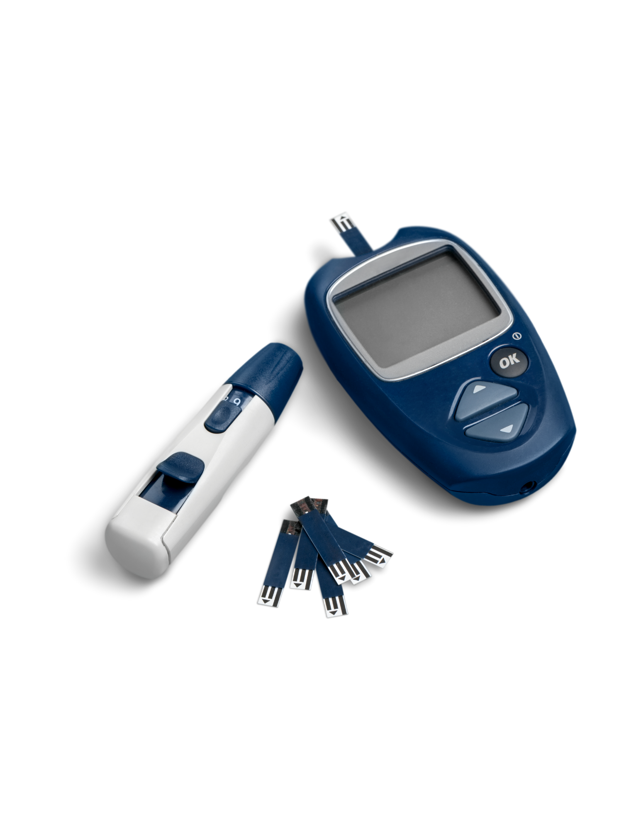
With Diabetes, You Have a Lot on Your Mind
Tracking blood sugar levels
Insulin dosage
Meal planning
Staying active

Slide 12
Diabetic Burn Out
Feeling run down
Emotionally drained
Overwhelmed

Slide 13
It’s Important to Stay in Touch with Your Emotions
What are you feeling?
Stressed out?
Angry? Sad?
Scared?
Take time to take inventory of your emotions and reach out to those around you or find a mental healthcare provider to guide you through your emotions.

Slide 14
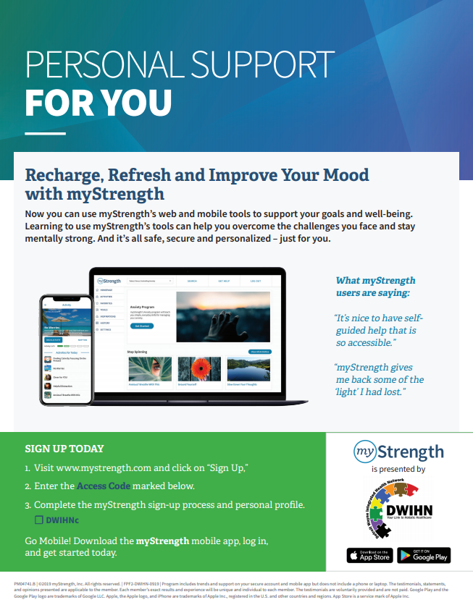

Slide 16
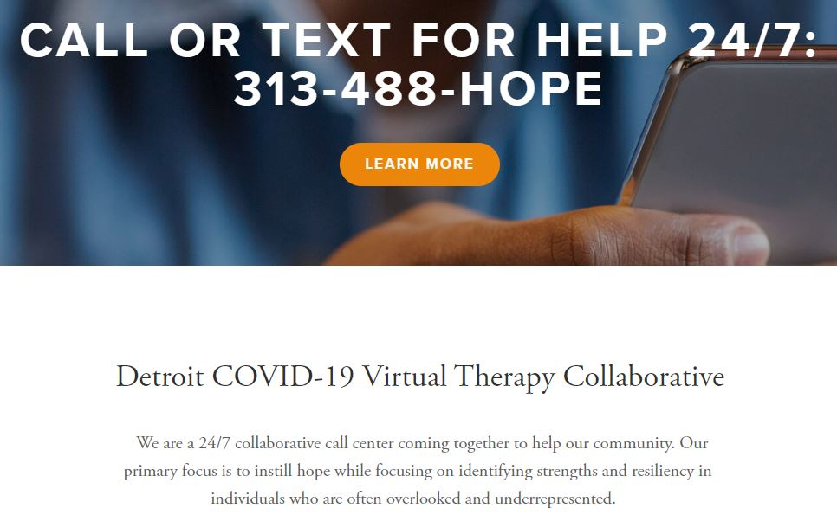
Reach Us Detroit

Slide 18
Resources
If you need help, or know anyone who needs assistance, call our 24-hour access number: 800-241-4949.
Visit http://dwihn.org for more information.
The National Alliance on Mental Illness Michigan (NAMI) offers help for people with depression and their families.
Visit http://namimi.org/ for more information or call 1-800-331-4264
https://www.diabetes.org/diabetes/mental-health

